Slide 1
Spatial Trajectory Generator
NAME | ENROLLMENT NO. | BRANCH
Priya Bansal | R970217030 | CSE-OGI
Siddarth Kumar Jha | R970217040 | CSE-OGI
Rahul Yadav | R970217051 | CSE-OGI
Anukriti Rana | R970217052 | CSE-OGI
Under the guidance of : Dr. Kingshuk Srivastava

Slide 2
Introduction
The increasing development of geographical information system (GIS) especially due to web technologies and collaborative tools is making the integration of such data by researcher's and applications more and more challenging .
Linear object representing spatial networks such as streets, railways, electrical or hydrographic networks are commonly the subject of many studies in geographic, urbanism, sociology or history. This project is concerned with the issue transition problem in such networks.
Statistical models, typically consisting of a collection of probability distributions which are used to describe patterns of variability that random variable or data may display. Markov model is one such model developed by Russian mathematician Andrei Andreyevich Markov.
It is assumed that future states depend only on the current state, not on the events that occurred before it. The simplest Markov model is the Markov chain. It models the state of a system with a random variable that changes through time. But, Markov Model can’t expect to perfectly observe complete true state of the system.
Thus, Hidden Markov model is the most used model for temporal and sequence data as it observed both the hidden states and the observed states. HMM is represented using Trellis diagram

Slide 3
Introduction
Markov chains is a probabilistic model that consists of finite state. The states are connected with each other through edges and there are probabilistic values that are associated with each of these matrix.
Forward & backward :- The forward–backward algorithm is an algorithm for hidden Markov models which computes the posterior marginal of all hidden state variables given a sequence of observations i.e. it computes, for all hidden state variables X_{t}∈{X₁,…,X_{T}} , the distribution P(X_{t} | o_{1:T}) .
Viterbi :- The Viterbi algorithm is a dynamic programming algorithm for finding the most likely sequence of hidden states called the Viterbi decoding path. It simplify the complicated problem by breaking down into simpler sub-problems in a recursive manner.
0.9
0.5
A
0.1
B
0.5

Slide 4

Objective
It’s time consuming to find the transverse probability of a location from another location so using mathematical calculation create a model and find the efficient way of transition. This will be achieved in 4 steps these are:-
1.Design the Markov chains.
2. Find the Transition probabilities matrix.
3. Find the Emission probabilities matrix.
4. Implement the HMM using all parameters

Slide 5

Problem Statement
With the increase in the geographical technology the no. of spatial networks maps are gradually increasing. So, the its becoming more and more difficult for cartographer to pin-point the exact location.
The moment from one transition state to another is easy when the exact co- ordinates are provided. But ,what about Traverse to an next location if the location are encoded?

Slide 6

Methodology
Literature Review.
Detailed study of Markov Model, Markov Chains.
Detailed study of the all the algorithms under Hidden Markov Model
Study of the selected algorithm for implementing the HMM.
Designing The process flow diagrams.
Development and Implementation.
Testing
Report writing

Slide 7

WORK DONE
Step 1 : Planning
Why HMM ?
HMM are powerful technique that are used in sequential and structure prediction
They are used to solve 3 problems :-
The Likelihood problem
The Decoding problem
The learning problem
Step 2: Analysis
For HMM 5 basic elements are required:
No. of state (Hidden)variable for HMM (N)
No. of Observed variable (M)

Slide 8
WORK DONE
3. State Transition matrix ( A=[a_{ij}]_{N*N}).
A_{ij} = P(X_{t+1}/X_{t}), Where
P(x_{t+1}) <= P(X_{t})
P(x_{t}) <= N
4. Observation probability matrix. (B = [b_{jk}]_{N*M})
B_{ij} = p(Y_{t}/ X_{t}), Where
P(Y_{t+1}) <= P(Y_{t})
P(Y_{t}) <= N
5. Initial state probability vector

Slide 9
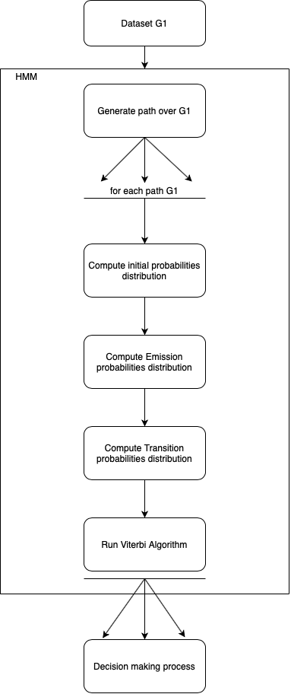
Step 3 : Design
Fig 1 Pipeline of proposed HMM process

Slide 10

References
[1] BERGE, C. Graphs, vol. 6. North-Holland, 1985.
[2] BAUM, L. E., AND PETRIE, T. Statistical inference for probabilistic functions of fi- nite state markov chains. The annals of mathematical statistics 37, 6 (1966), 1554–1563. doi:10.1214/aoms/1177699147.
[3] HUNTER, G. J. Managing uncertainty in GIS. Geographical information systems 2 (1999), 633–641.
[4] JIANG, B., ZHAO, S., AND YIN, J. Self-organized natural roads for predicting traffic flow: A sensitivity study. Journal of Statistical Mechanics: Theory and Experiment (July 2008). doi:10.1088/1742-5468/2008/07/P07008.
[5] Costes, Benoit and Perret, Julien (2019) "A hidden Markov model for matching spatial networks," Journal of Spatial Information Science: No. 18, 57-89.

Slide 11
THANK YOU!!
ANY QUESTIONS??

